Slide 1
UPF
Unified power format
Mitta Bhuvaneswar

Slide 2
Introduction
What is UPF & use of UPF ?
What are Low power cells ?
Format of UPF file ?

Slide 3
What is UPF & use of UPF ?
It is a power specification file used in the design cycle to implement low-power design approaches. UPF is known as Unified power format.
Power has become as crucial as time and area in the design flow with power being a more significant aspect in today’s electronic systems, there is a need for a more systematic approach to Reducing power in complicated designs,UPF in VLSI was created to meet this requirement.
It is used when there are multiple voltage /power domains in our design.

Slide 4
Low power cells
set_Isolation_cell
set_Retention_cell
set_Level_shifter
AON / AOFF
create _Power_switch

Slide 5
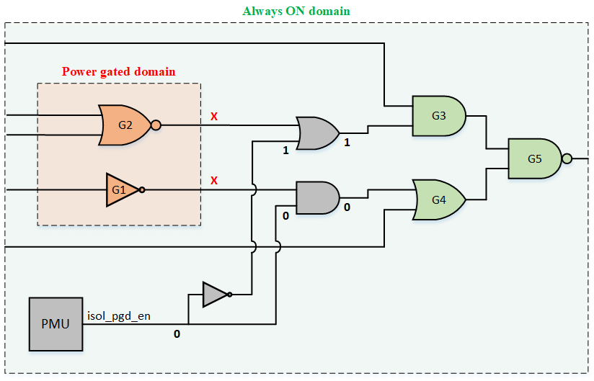
Isolation cell
Used to protect logic that is powered on from logic that is powered off ,Used to prevent lekage current.
Isolation cells are also known as CALMP CELL .
Clamp “0” perform AND.
Clamp “1” perform OR.
Syntax :
Set_isolation_ power_domain
-isolation_power_net
isolation_ground_net
-isolation_supply_set
-isolation_signal
-source_supply_set_name
-sink_supply_set_name
-Clamp_value
-Isolation _sense
-Isolation_high
-Location ( self,fanout,parent)

Slide 6
Retention cell
A Sequential element that can retain its value despite being powered off.
Useful to recover the last known state of the design when power was removed. Reduces the amount of time needed reset a design to a specific state to continue operation.
syntax : set_retention_cell -domain -retention supply_set
Set_retention_ control –domain -restore signasave signal

Slide 7
Level shifter
There are different types of level shifters
1.High to low : high to low LS are used for signals crossing from higher voltage domain to lower voltage domain.
2. Low to high : low to high LS are used for signals crossing from a lower voltage domain to higher voltage domain.
3. Enable level shifter an enabled level shifter cell is one that can perform both level-shifting and isolation tasks
Set_levelshifter -domain -applies_to -rule -location

Slide 8
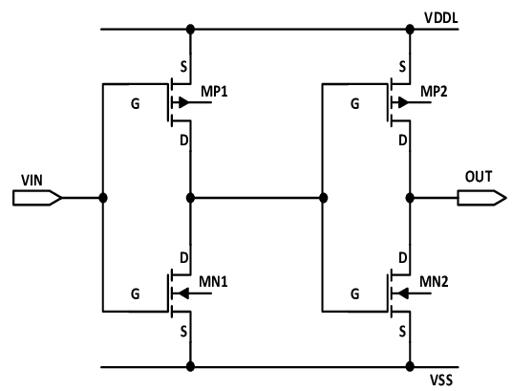
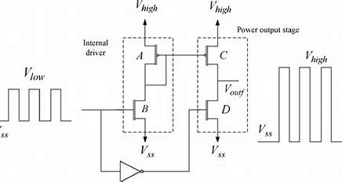
Circuti diagram of H-L and L-H level shifters
High to low level shifter
Low to high level shifter

Slide 9
AON cells
These cells are always on irrespective of where they are placed.
Generally buffer and inverters are used for always ON cells.
Always cells are also present in UPF. They can be a special cell or regular buffer.
If they are special cells they have their own secondary power supply and placed anywhere in the design.
define_always_on_cell -cells AON_BUF -power_switchable VDD1P0_SW -ground_switchable VSS

Slide 10
Create power switch
A power switch is used to implement the power gating for a power domain. Power switch that we create in UPF is an abstract model of the actual power switch network.
Creating the power switch in UPF serves two purposes. One it captures the power intent of the designer and two it can be used for low power verification.
Mapping power switch :The supply nets specified in the create_power_switch should already exist in the design.
Syntax:
create_power_switch -domain
-output_supply_port
-input_supply_port
-control_port
-on_state
-ack_port
-ack_delay
Map_power_switch –domain –lib_cells

Slide 11
What UPF file contains
Upf version
Create Supply set
Create Power domain
Create Power switch
Set Isolatioin
Set Retention
Set level shifters
Set Port attributes
Power state table

Slide 12
UPF commands
create_supply_net vss
create_supply_net vdd
create_supply_set shigh –function vss –function vdd
create_power_domain design_top –elements risc_core –supply shigh
create_supply_port vss –domain design top –direction in
connect_supply_net vss –ports vss

Slide 13
Power state table
Add_power_state –supply -state {-supply_expr {power == {on }}}
add_port_state -state
Add_pst –state

Slide 14
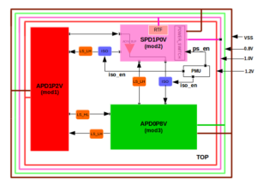
Example of
This design consists of default with three different voltage domains APD1P2V, SPD1P0V and APD0P8V.
APD1P2V – Always on power domain with 1.2V supply
SPD1P0V – Switching power domain with 1.0V supply
APD0P8V – Always on power domain with 0.8V supply
LS_LH – Level shifter low to high
LS_HL – Level shifter high to low
ISO – Isolation cellRTF – Retension Flop
PMU – Power management unit
AON_BUF –Always on buffer

Slide 15
Thank you

